Slide 1


NFT SEAROCK Driven by Innovation

Slide 2

TABLE OF CONTENTS
01
02
03
Severity of the Problem
Market Size
Existing Solutions on The Market
04
05
06
Why Market Needs Our Product
Team Behind The Product
Financial Plan
Unmet NFT marketplace needs.
Overview of The Market Sizes by NFT Marketplace type
Overview of Key Competitors
The economies of our product introduction to the market
Our Competitive advantage and edge on the market
The human resource that will transform the idea into reality

Slide 3

Severity of The Problem
01

Slide 4

NFT Marketplace Challenges
Increasing demand on NFTs are poorly met by existing solutions.
High gas fees are the major roadblock for marketplace users, especially for small transactions.
No one universal marketplace exists that covers the broad span of NFT Types that are now traded on scattered marketplaces.

Slide 5
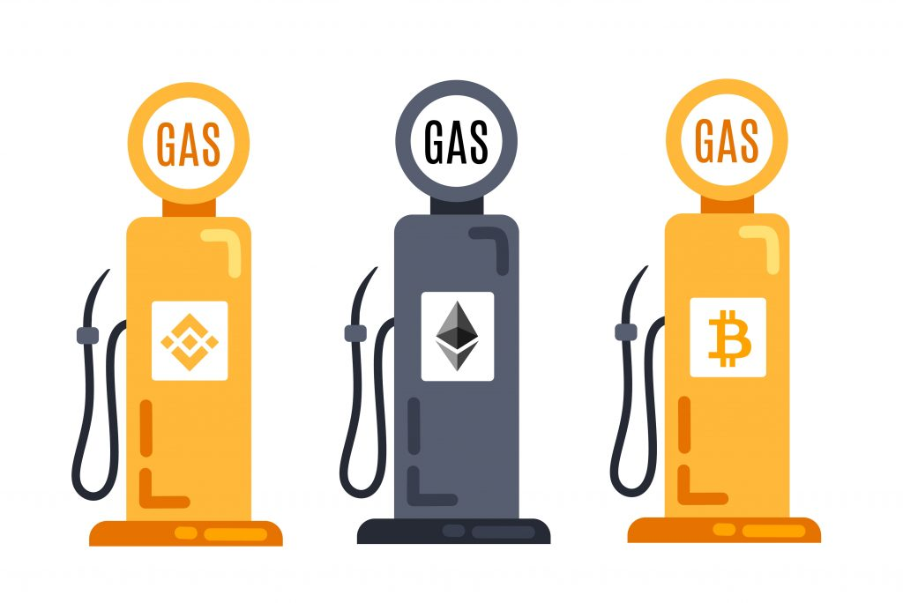
High Gas Fees
Marketplaces that use single blockchain support face growing gas fees that users have to bear.
Etherium based marketplaces sometimes impose on transactions higher than 100% of transaction value gas fees.
High Gas Fees Remain one of the main challenges of NFT world.

Slide 6

Scattered NFT Marketplace
No one, overarching marketplace exists where enthusiasts can trade different sorts of NFTs.
Different NFT types are clustered on many different marketplaces.
That makes it hard for NFT Enthusiasts to have optimal trading experience.

Slide 7
Market Size
02

Slide 8
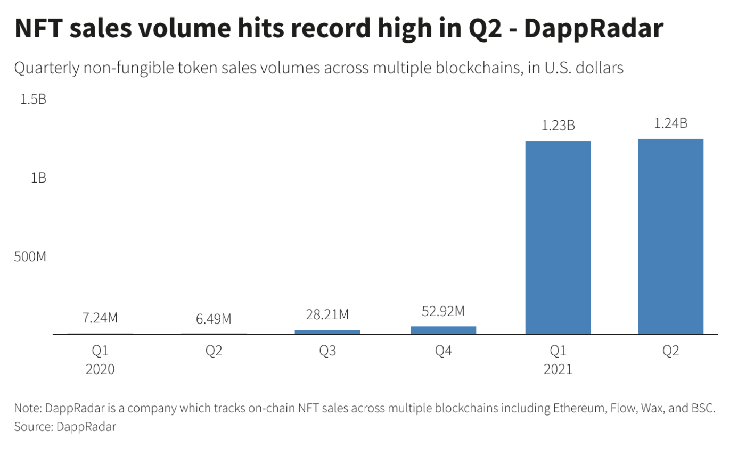
Booming NFT Market Drivers
2021 Year Blockchain Resurrection Caused Renewed Interest in NFT
Covid-Spikes Resulted in less social activity and more time for people to explore online opportunities.
In 2021 first three quarters, NFT market rose unprecedently.

Slide 9
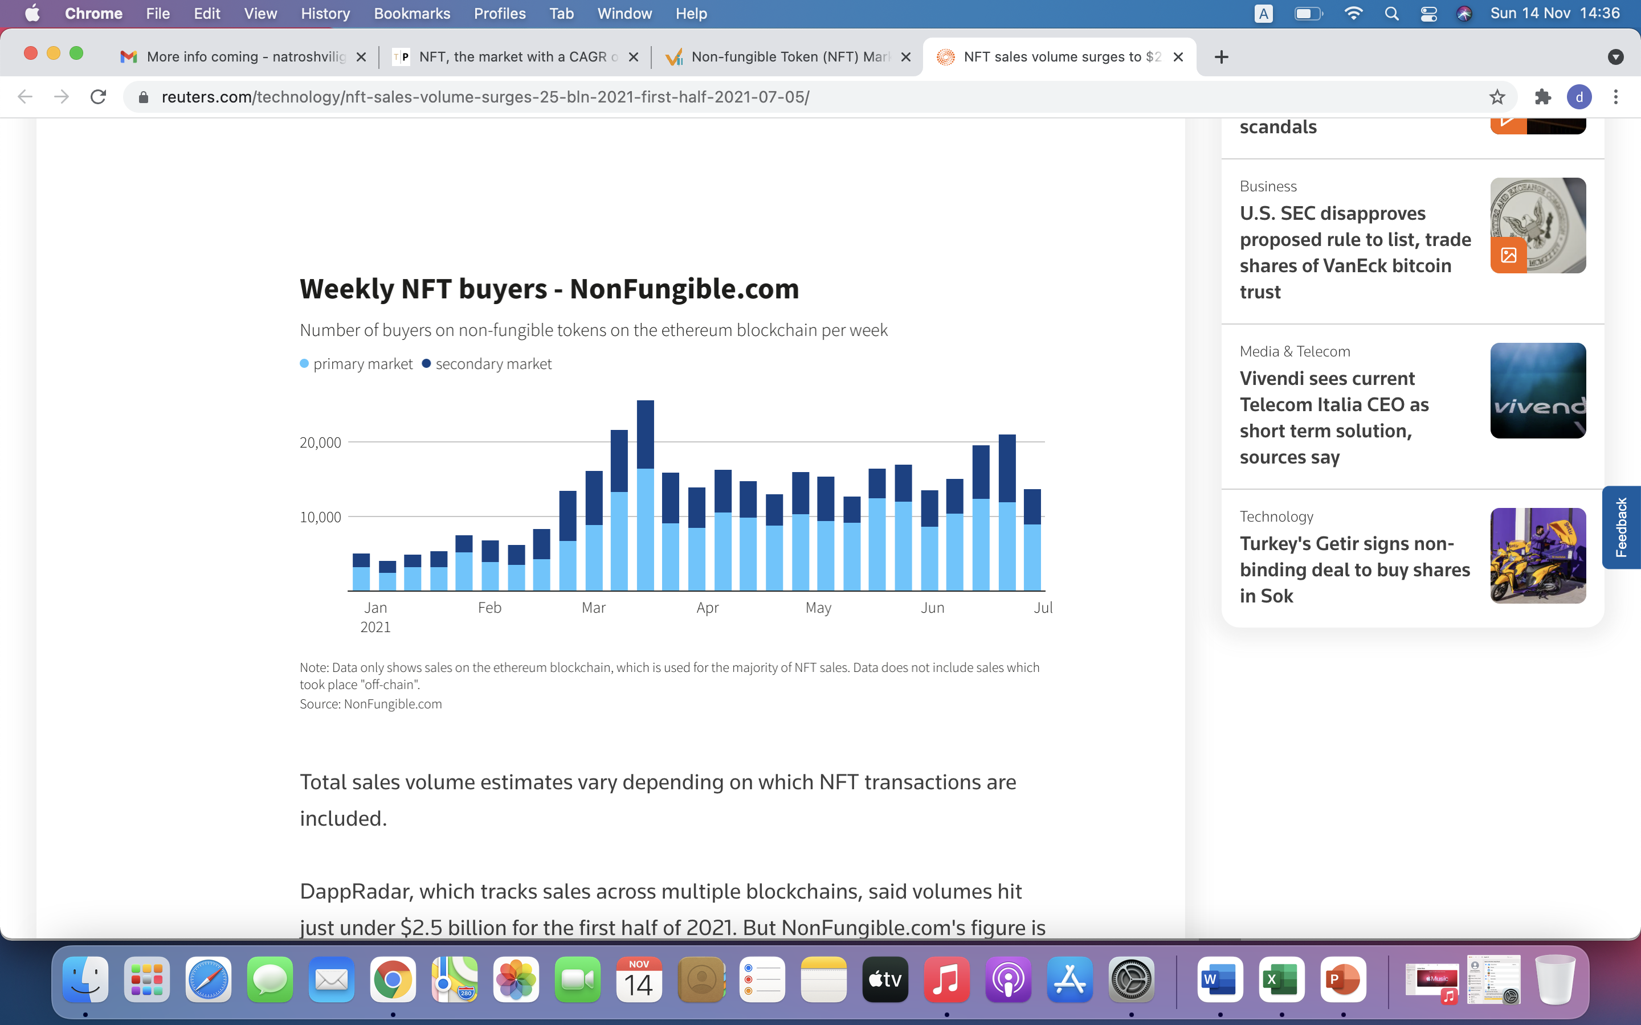
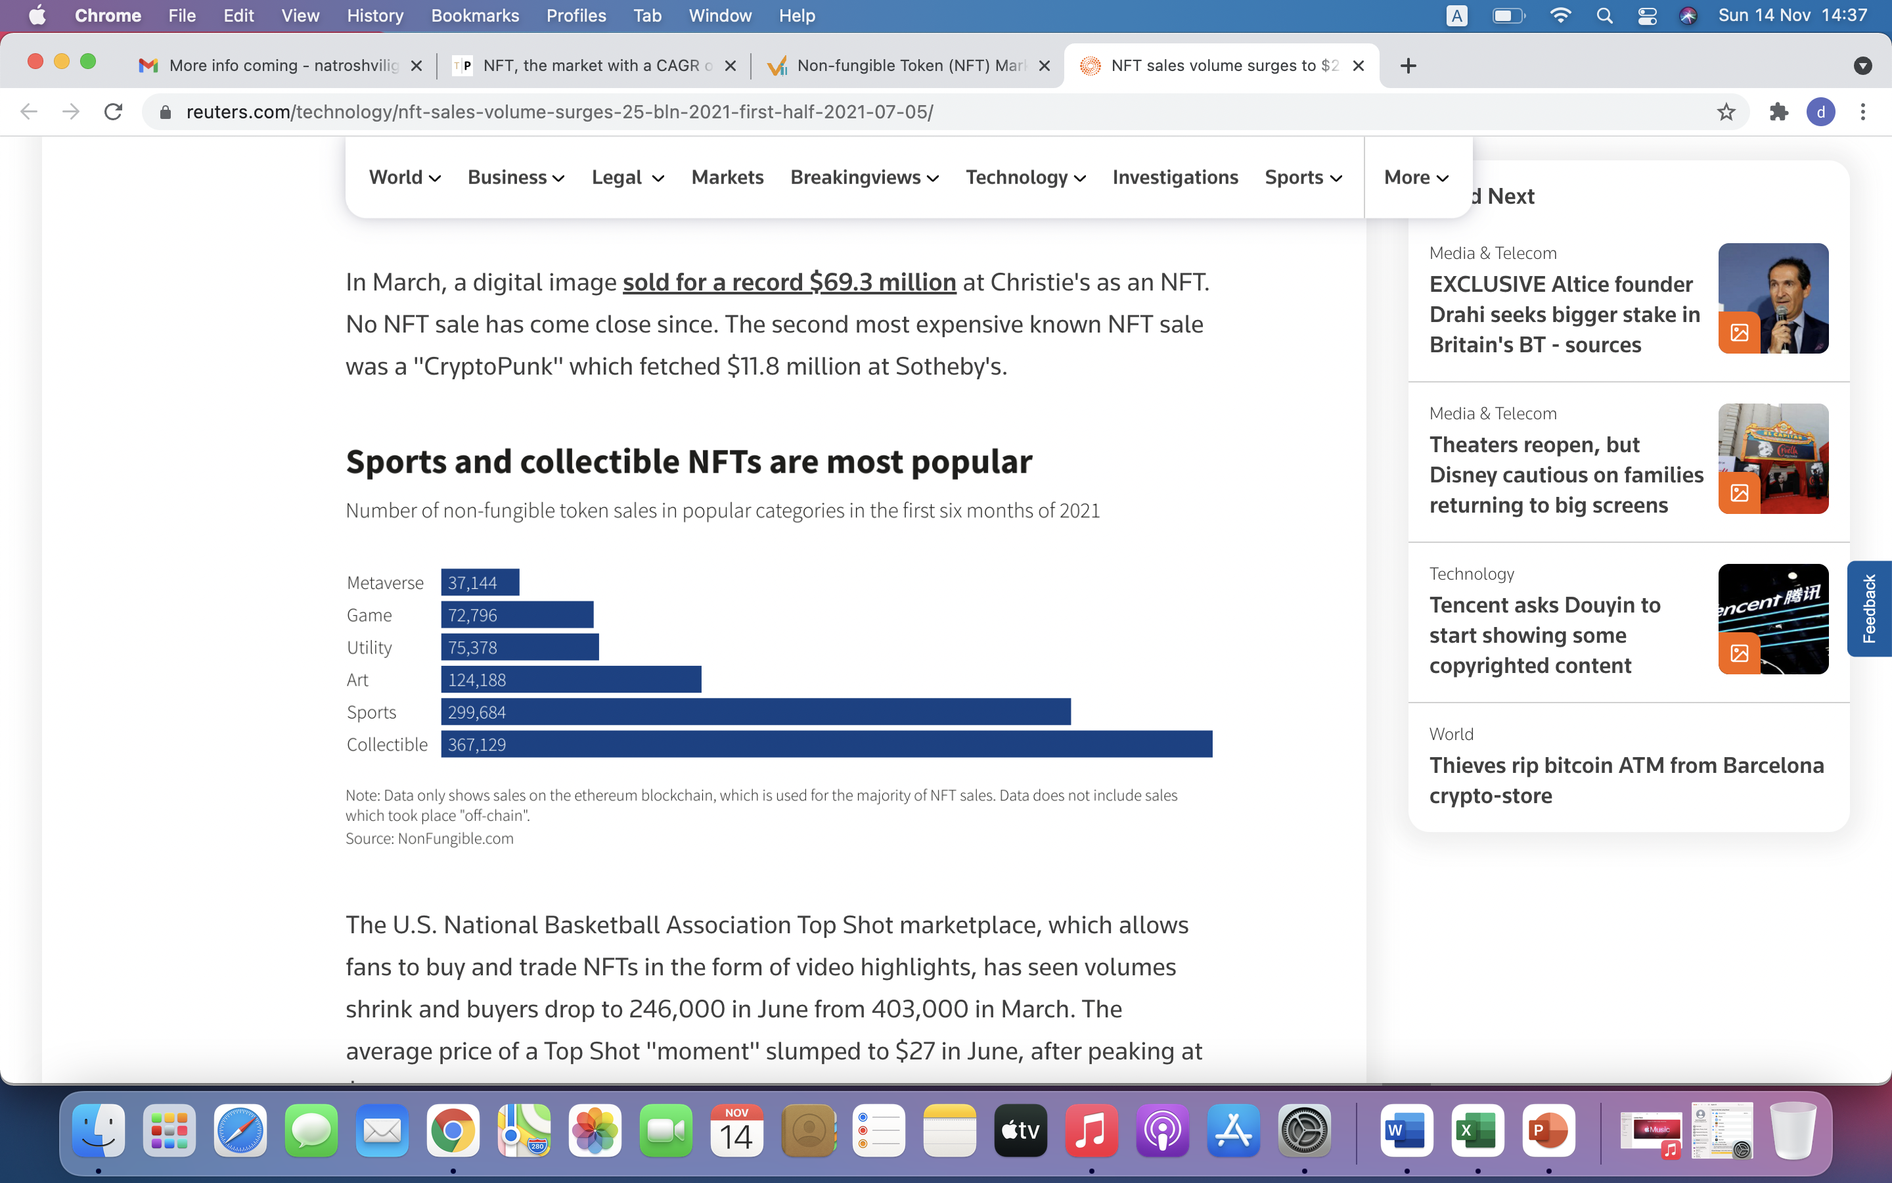
Booming NFT Market Drivers-(Part II)
As new Types of NFTs became Popular, Primary Sales accounted for most of the trading volume.
Sports And Collectibles remained the Key Drivers of the market throughout the year

Slide 10
NFT Market Size and Estimated Growth
2020 Closed with 250M Worth of Sales
From 2021 to 2025 Average CAGR is estimated to be in 187-500% Range.
83,521M
28,700M
250M
10,000M
2020
2021
2022
2023

Slide 11

03
Existing Solutions on the Market

Slide 12



Existing Solutions
High Platform Fees
Very Specialized Markets
High Gas Fees
Existing Markeplaces charge both buyers and Sellers a very high fees on transactions
Because most of the marketplaces use single blockchain (ETH) gas fees are outrageous
Different NFT types are clustered on different platforms, Users have to be registered on several websites

Slide 13

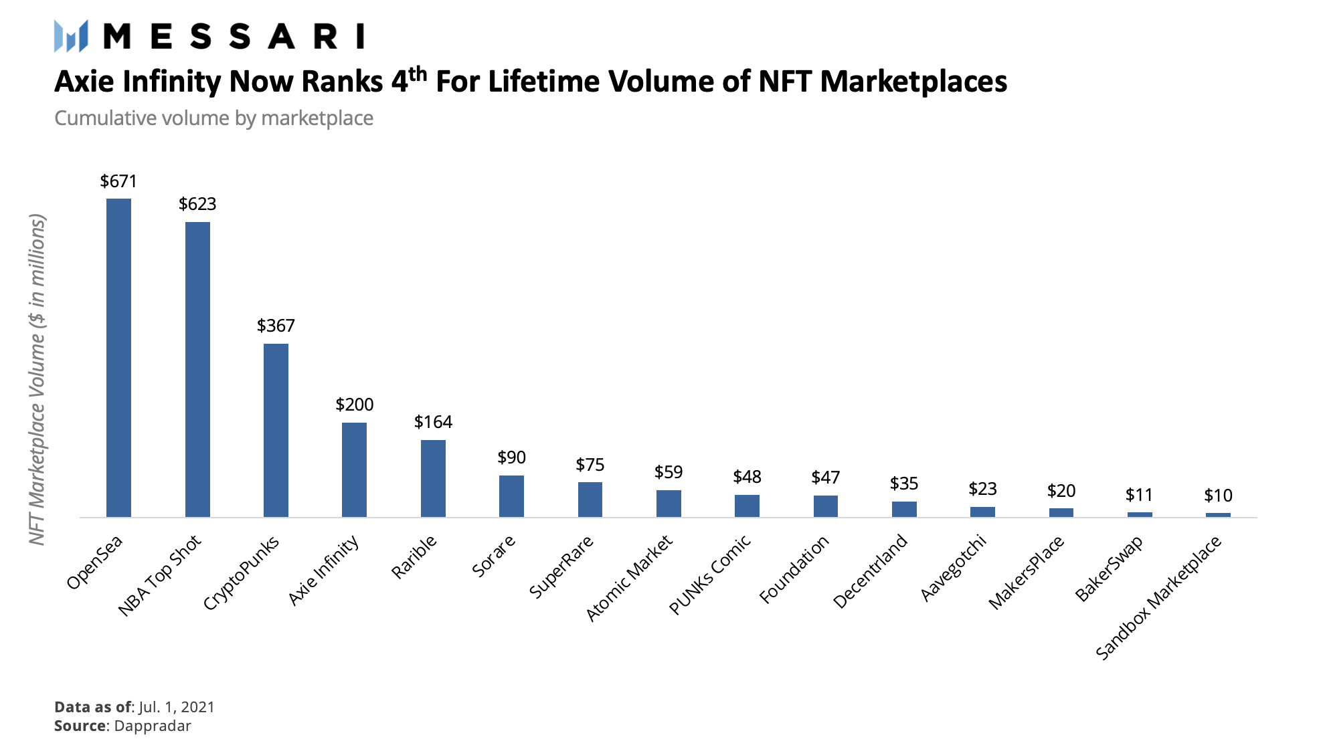
Top Players

Slide 14
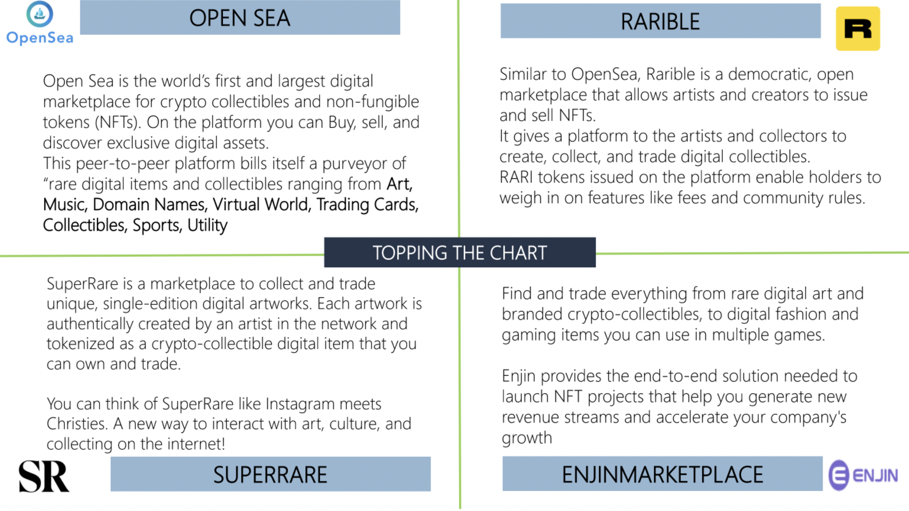
Top Players (Part II)

Slide 15
Typical Customer
77%
23%
55,000$
GENDER
AVERAGE INCOME PER CUSTOMER
Under 25
Coding
AGE
Crypto

Slide 16
04
Why Market Needs Our Product

Slide 17

MISSION STATEMENT
To create low-fee and gas-free marketplace with the broadest range of NFT categories.

Slide 18
Uniqueness of NFT SEAROCK
One of the first marketplace to employ multi-chain platform and thus offer individuals gas-free trading experience.
One of the first marketplaces to offer wide range of NFT from digital to physical.
First NFT Marketplace to launch its own Fashion Company.

Slide 19
COMPETITION ANALYSIS
CryptoPunks | OpenSea | Axie Infinity | SEAROCK
Gas-Free
Low Transaction Fees
Fashion-Heavy
Wide Range of NFts
Own Fashion Firm

Slide 20


THEM
US
Offer high fee trading experience that is even more burdened by unrealistic gas fees. Their marketplaces offer very narrow range of NFTs
We unleash the power of multi-blockchain marketplace and offer users gas-free experience. We have the widest variety of NFTs

Slide 21

Marketing Plan
Running Paid ads on Facebook targeting developed countries
Sponsoring events that promote NFT trading.
Supporting local organizations and gaining brand recognition
Digital Marketing
Event Sponsorship
Local Support

Slide 22
05
Team Behind The Product

Slide 23

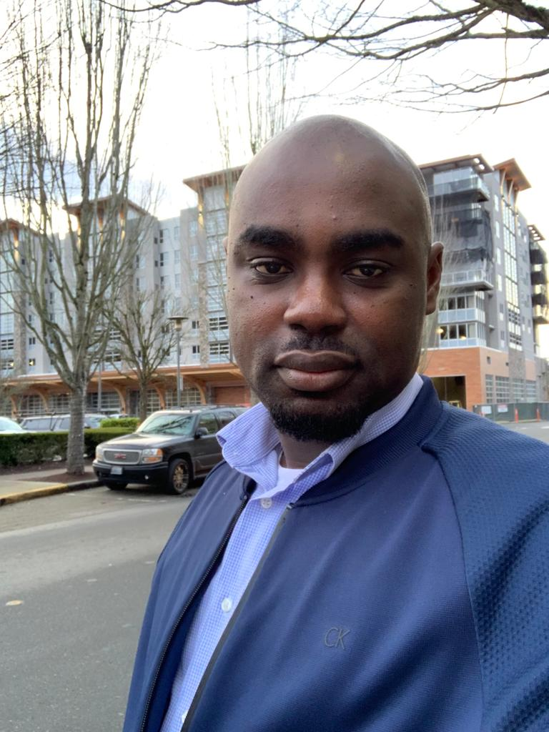

People Who Will Turn Vision into Reality
Paul Momoh - Founder
Ogheneogaga Fidelis Agi – Software Developer
Omoalhaja Abiola – Experienced Blockchain Writer

Slide 24
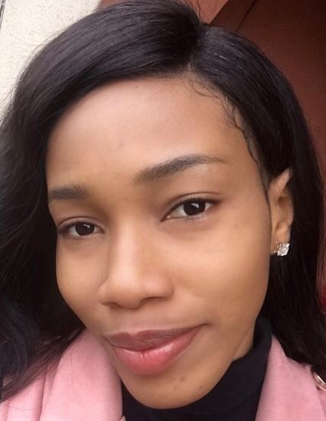
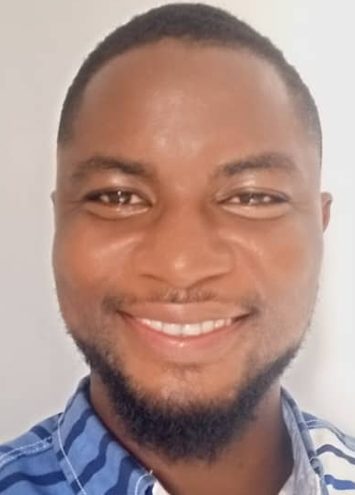
People Who Will Turn Vision into Reality (PART II)
Sandra Jombo - Consumer Experience Design and Strategy.
Thompson Davies - Deputy Creative Manager

Slide 25

06
FINANCIAL PLAN

Slide 26
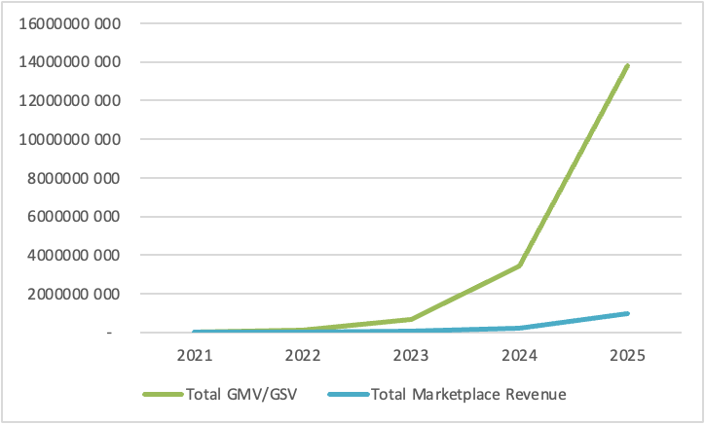
PREDICTED GROWTH by Years

Slide 27
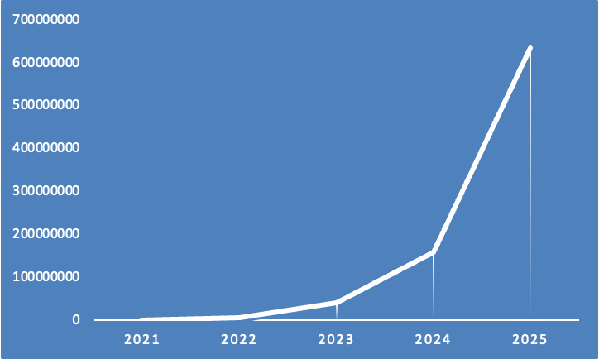
Profit By Years

Slide 28
Valuation of The Company
Present value free-cash-flow | $ 225 010 187.54
Present value of continuing value | $ 688 840 050.65
DCF | $ 913 850 238.19

Slide 29
Thank You For Your Attention!

